Slide 1
BUAN/MIS 6356 BA with R
Association Rules and Collaborative Filtering

Slide 2
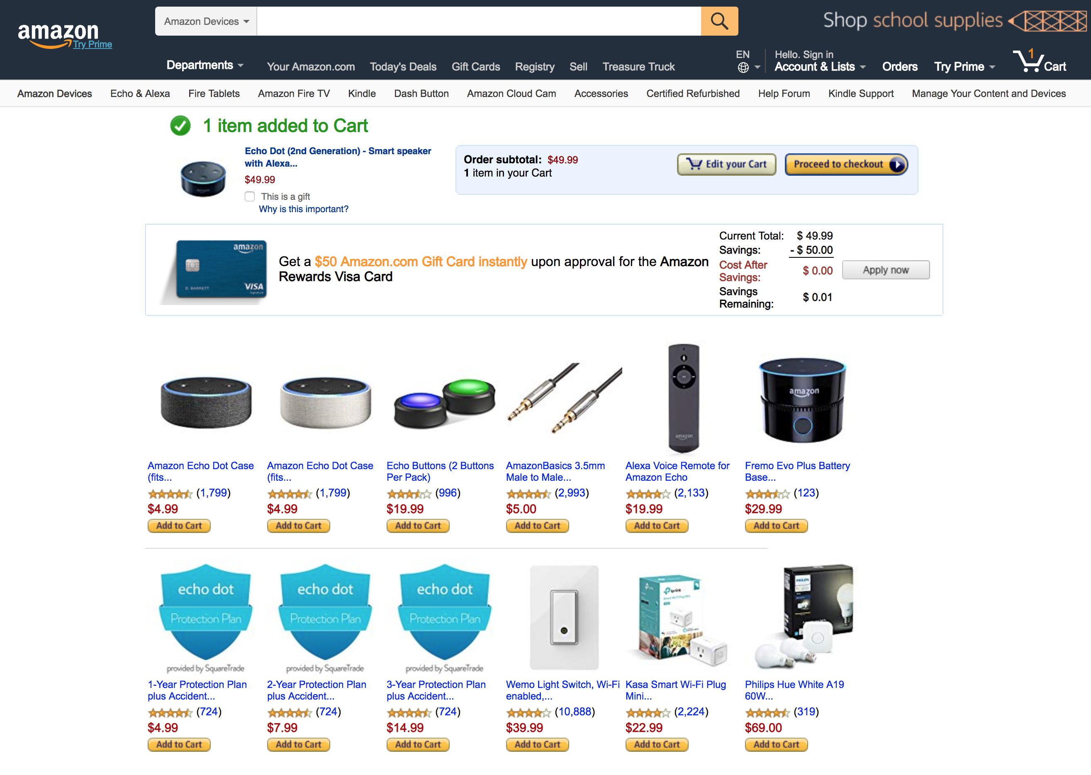
Recommender Systems

Slide 3
Primary Methods for Recommender Systems
Association Rules
Useful for frequently bought items
Market basket or shopping cart analysis
Collaborative Filtering
Useful for infrequently bought items and frequently bought items
Identify items or users that are most similar to each other

Slide 4
Association Rules

Slide 5
Association Rules
Given a transactional database (set of transactions), find rules that predict the occurrence of an item based on the occurrences of other items in the database.

Slide 6
What are Association Rules?
Identify relationships between and among items in a transaction dataset
Also called market basket analysis or affinity analysis
Examples of Association Rules
{Diaper} → {Beer}
{Milk, Bread} → {Eggs,Coke}
{Beer, Bread} → {Milk}
Implication means co-occurrence, not causality

Slide 7
Why Do We Care?
eCommerce recommendations
Based on what you have in your shopping cart, you might also like….
In-Store Product Placement
Together of far apart are both possible
Needs to support strategy of store
Typically requires an A/B store layout test
Streaming Music and Video Services
Netflix, Spotify, etc.

Slide 8
Rule Format
If {set of items} ⇒ then {set of items}
If {diapers} ⇒ then {beer}
{diapers} : Antecedent or Body of the rule
{beer} : Consequent or Head of the rule
The antecedent of a rule implies its consequent

Slide 9
Evaluating Association Rules
Which rules are valid?
Relevance
Strength
Lift
An association rule is considered valid if it satisfies evaluation measures, quantifying the relevance, strength, and lift of the rule.

Slide 10
Evaluating Association Rule Relevance
Relevance measured by support
Frequency of transactions in which the items in the antecedent and the consequent co-occur.
Probability that a transaction contains antecedent and consequent
Support for {bread} ⇒ {diapers} is 2/4
50% of transactions include this pair of items
Support quantifies the significance of the co-occurrence of the items involved in a rule.

Slide 11
Evaluating Association Rule Strength
Strength measured by confidence
Proportion of transactions containing antecedent that also contain the consequent.
Conditional probability that a transaction containing the antecedent also contains the consequent.
Confidence for {bread} ⇒ {diapers} is 2/3
2/3 of transactions involving the purchase of bread also involved the purchase of diapers

Slide 12
Example
A rule should meet a minimum support and a minimum confidence.
Both thresholds determined by decision maker.
An association rule found in a cell phone company database containing all call destinations for each account was
{Germany} ⇒ {France, Belgium}
Confidence = 100%!
Support is 0.0001 (1 of 100K accounts)
Why is this not a useful associate rule?

Slide 13
Valid Association Rules
A rule has to meet a minimum support and a minimum confidence.
Both thresholds determined by decision maker.
Minimum support: 50%
Minimum confidence: 50%
↓
Two Rules
Bread ⇒ Diapers
Support = 50%, Confidence = 66.67%
Diapers ⇒ Bread
Support = 50%, Confidence = 100%

Slide 14
Example
Bread ⇒ Milk
Support = ?, Confidence = ?
Milk ⇒ Bread
Support = ?, Confidence = ?

Slide 15
Caveat About Confidence
Tea ⇒ Coffee
Confidence = sup(Coffee & Tea)/sup(Tea) = 15/20 = 75%
i.e., the probability that someone who has bought tea will also buy coffee, P(Coffee⏐Tea) is 75%.
Seems good?

Slide 16
Caveat About Confidence
Tea ⇒ Coffee
BUT P(Coffee) = sup(Coffee) = 90/100 = 90%
i.e., the probability that someone would have bought coffee is 90%
So the probability of buying coffee has dropped, given that tea has been bought.
Although confidence is high, rule is misleading!

Slide 17
Evaluating Association Rule Lift
The lift of a rule measures how much more likely the consequent is, given the antecedent
Lift takes into account statistical dependence
Tea ⇒ Coffee
Confidence = P(Coffee | Tea) = 75%
P(Coffee) = 90%
Lift = 0.75/0.9 = 0.833 < 1 ⇒ negatively correlated.
WHY?

Slide 18
Statistical (In)Dependence and Lift
Population of 1000 students
600 students know how to swim (S)
700 students know how to bike (B)
300 students know how to swim and bike (S, B)
If swimming and biking are statistically independent, we would expect the probability that someone knows how to bike and swim would be equal to 0.42
P(S) × P(B) = 0.6 × 0.7 = 0.42
However, using data from the table above, the probability that someone knows how to swim and bike is is 0.30
P(S and B) = 300/1000 = 0.30
If P(S and B) = P(S) × P(B) ⇒ Statistical independence
If P(S and B) > P(S) × P(B) ⇒ Positively correlated
If P(S and B) < P(S) × P(B) ⇒ Negatively correlated

Slide 19
Evaluating Association Rule Strength
Another example: {diapers} ⇒ {beer}
# of customers in database: 1000
# of customers buying diapers: 200
# of customers buying beer: 50
# of customers buying diapers & beer: 20
Support of Rule: 20/1000 = 0.02 (or 2%)
Confidence of Rule: 20/200 = 0.1 (or 10%)
Support of Consequent: 50/1000 = 0.05 (or 5%)
Lift: 0.1/0.05 = 2 > 1 ⇒ Positively correlated.

Slide 20
Example
Calculate support, confidence and lift for each of the rules listed below.
{Diaper} → {Beer} {Milk, Bread} → {Eggs,Coke} {Beer, Bread} → {Milk}

Slide 21
Other Evaluation Criteria: Impact
Many rules are either obvious and uninteresting.
{Maternity Ward} ⇒ {patient is woman}
Confidence 100%, support 100%
Screen for rules that are of particular interest and significance.
Use domain specific conditions to filter generated rules.
Some thoughts:
Actionability
Keep only rules that can be acted upon.
“Interestingness”
Various measures for how surprising or unexpected a rule is.
E.g. Rule is interesting if it contradicts what is currently known (e.g., it contradicts a rule that was previously discovered).

Slide 22
Generating Association Rules
Standard approach: Apriori algorithm
Developed by Agrawal et al (1994)
Problem was defined as:
Generate all association rules that have
support greater than the user-specified support threshold min_sup (minimum support) , and
confidence greater than the user-specified confidence threshold min_conf (minimum confidence)
The algorithm performs a (relatively) efficient search over the data to find all such rules.

Slide 23
Generating Association Rules
Problem is decomposed into two sub-problems
Find all sets of items (itemsets) with support above min_sup
Itemsets with support ≥ min_sup are called frequent itemsets.
From each frequent itemset, generate rules that use items from that frequent itemset.
Given a frequent itemset Y, and X, a subset of Y
Take the support of Y and divide it by the support of X
Estimates confidence c of the rule X ⇒ (Y\X)
If c ≥ min_conf, then X ⇒ (Y\X) is a valid association rule

Slide 24
Phase 1: Finding Frequent Itemsets
Subsets of frequent itemsets must also be frequent
If a frequent itemset has size n, all subsets of size (n-1) are also frequent
If {diaper, beer} is frequent, then {diaper} and {beer} are also frequent
Therefore, if an itemset is not frequent then no itemset that includes it can be frequent.
if {wine} is not frequent then {wine, beer} cannot be frequent.
We start by finding all itemsets of size 1 that are frequent.
We then try to “expand” these by counting the frequency of all itemsets of size 2 that include frequent itemsets of size 1.
Next, we take itemsets of size 2 that are frequent, and try to expand them, and continue expanding this way until we cannot expand further.
Notes:
Stopped here on Sept 12, 2011

Slide 25
Phase 2: Finding Association Rules
Suppose {Milk, Bread, Butter} is a frequent itemset.
For each such frequent itemset, find all possible rules of the form Antecedent ⇒ Consequent using items contained in the itemset.
Does {Milk} ⇒ {Bread, Butter} have the minimum confidence?
Similarly, {Bread} ⇒ {Milk, Butter}, {Butter} ⇒ {Milk, Bread}, {Bread, Butter} ⇒ {Milk}, {Milk, Butter} ⇒ {Bread}, {Milk, Bread} ⇒ {Butter}
The confidence of the rule {Milk} ⇒ {Bread, Butter} is calculated as
sup{Milk, Bread, Butter}
sup {Milk}

Slide 26
Mining Example
Minimum support: 40%
Minimum confidence: 80%
Phase 1
1-item itemsets
{Beer} (support = 0.8)
{Diapers} (support = 0.6)
{Chocolates} (support = 0.4)
2-item itemsets
Only need to check {Beer, Diaper}, {Beer, Chocolates} and {Diapers, Chocolates}
{Beer, Diapers} (support = 0.6)
Done with Phase 1.

Slide 27
Another Example
Minimum support: 40%
Minimum confidence: 80%
Frequent Itemsets were
{Beer} (sup = 0.8), {Diapers} (sup = 0.6), {Chocolates} (sup = 0.4) and {Beer, Diapers} (support = 0.6)
Phase 2:
For each frequent itemset of size ≥ 2 (containing at least 2 items), find all rules that satisfy minimum confidence.
{Beer} ⇒ {Diaper} has confidence = 3/4, or 75% (which is < 80%)
{Diaper} ⇒ {Beer}, has confidence = 3/3, or 100%(which is > 80%)

Slide 28
Additional Thoughts
Physical Stores
Product placement in stores could help or hurt depending on customer tendencies
Should we place associated items together?
Need to conduct chainwide A/B test to determine to determine optimal store layout
Websites
Recommend product based on items in shopping cart
Physical stores
Train staff to know commonly purchased items and provide recommendations
Have cash register prompt employee to ask about additional purchases
Call Centers
Recommendations are widely used in call centers as well

Slide 29
Charles Book Club Example
Sample of 4,000 records
Variable | Description
Seq# | Sequence number in the sample
ID# | ID# in the full dataset
Gender | 0=male, 1=female
M | Monetary - total money spent on books
R | Recency - Months since last purchase
F | Frequency - Total number of purchases
FirstPurch | Months since first purchase
Col H - R | book categories
Related Purchase | Number of related books purchased
Mcode, Rcode, Fcode | Recoding of M, R and F - see case description in DMBA

Slide 30
Association Rules Example in R
Requires the following packages
arules
Matrix

Slide 31
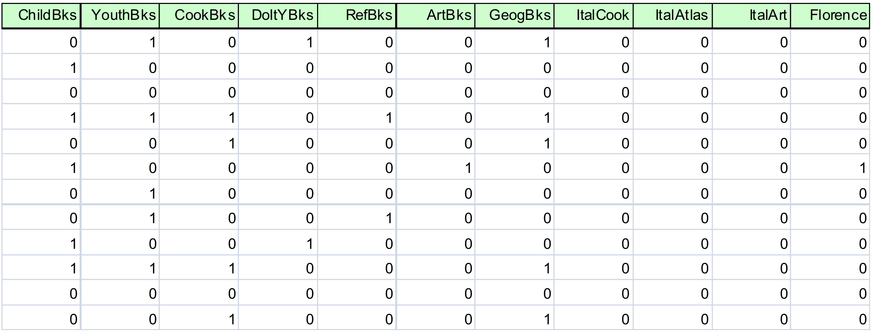
Example – Charles Book Club
Data must be in Binary Matrix Format for R
Each row represents a customer transaction and each column represents a binary yes/no whether or not a book was purchased in the product category

